Slide 1
DS ML – Week 1 Machine Learning Introduction, Python, NumPy & Pandas
Notes:
ML is the most sexy part of ML.
It is really fun to learn and apply ML, you can really build cool applications with ML.

Slide 2
Content
Who are your Teachers?
Machine Learning Products
Learning Objectives
Overview Machine Learning Lessons
Material
Pre-requisites & expectations?

Slide 3
Contact Info Teachers
Martijn Lamers
m.lamers@fontys.nl
R1, 2.33
Peter Lambooij
p.lambooij@fontys.nl
R1, 4.48

Slide 4


Slide 5
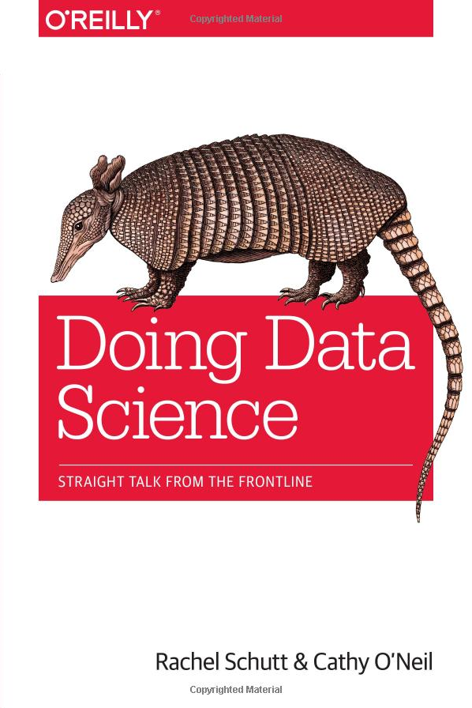
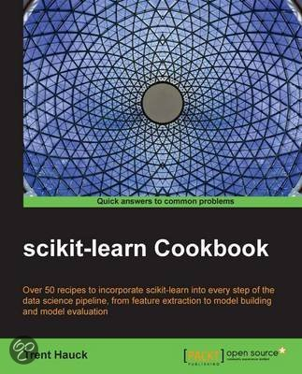
ADS-ML Material
Provided course material
PPT’s
Prepared IPython Notebooks
Datasets (*.csv)
MOOCs
Introduction to Machine Learning (https://www.udacity.com/course/intro-to-machine-learning--ud120)
Literature (suggested reading)
Notes:
Doing Data Science is a good book, focus on the theory, includes some math, uses R.
Scikit-learn is more practical. Shows how to program with Python scikit-learn.

Slide 6

Machine Learning Products
With Machine Learning you can create amazing products & services!
Recommendation Engines

Slide 7


Machine Learning Products
With Machine Learning you can create amazing products & services!
Credit card fraud detection

Slide 8

Machine Learning Products
With Machine Learning you can create amazing products & services!
In this course you will program face recognition in IPython with SVM.
Face recognition

Slide 9

Machine Learning Products
With Machine Learning you can create amazing products & services!
Skin Vision App

Slide 10
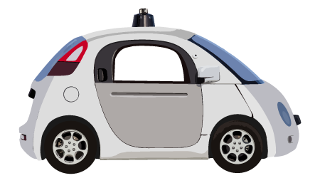
Machine Learning Products
With Machine Learning you can create amazing products & services!
Self-driving Cars

Slide 11

Learning Objectives
Assess if a prediction problem can be molded into a machine learning paradigm.
Adapt data to make it suitable for a machine learning.
Critically choose a machine learning model to solve a problem.
Work with the Python modules Scikit-Learn, NumPy, Pandas, and Matplotlib.
Assess the quality and reliability of your model-based prediction.
Present your data analysis in an IPython Notebook.
Notes:
Along this course you will learn to:

Slide 12
Machine Learning Lessons
wk | topics
2 | Python / Numpy / Pandas
3 | Unsupervised Learning: Clustering, Feature Engineering, PCA
4 | Supervised Learning: Classification by Eye, K-NN
5 | Support Vector Machines, K-fold cross-validation
6 | Neural Networks, Hyperparameters/GridSearch
7 | Naive Bayes, Decision Trees
8 | Comparing Supervised Algorithms, Metrics, Investigating Generalisation Intro individual ML challenge
9 | Regression
11 | Bagging / Boosting, Approval dataset/plan individual ML challenge
12 | Tutoring ML / PT
13 | Tutoring ML / PT
14 | Tutoring ML / PT
15 | ML final assessments
Notes:
Machine learning lessons at a glance.
@4: Focus is on understanding ML. You need to understand something before you can program it!
@5: Face recognition case!
@7: Here we will use the original Titanic dataset. Who has a high chance to survive the disaster?
@9: Handwriting recognition

Slide 13
End Terms
Show that you have mastered all the ML learning objectives with an individual project (in week 11 – 15).
Final ML interview in week 15

Slide 14
Machine Learning Tools
Python (most popular DS language)
NumPy (data wrangling)
Pandas (data wrangling)
MatPlotLib (visualisation)
Jupyter Notebook (calculation and recording your work)
Scikit-learn (sklearn, the actual machine learning library)

Slide 15
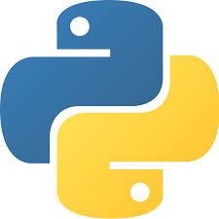
Python
First released early 90s
BDFL is Dutch!
General purpose scripting language
Wraps many C(++) and Fortran based libraries
Standard (for prototyping) in scientific computing
Lots of domain specific libraries (e.g for machine learning)
Thriving community; remains innovative
Available on many platforms
Notes:
Based on 10 yrs programming language research at CWI (centrum Wiskunde & Informatica)
BDFL: Benevolent Dictator for Life: Guido van Rossem
Source of inspiration for many other languages

Slide 16
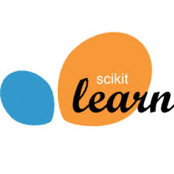


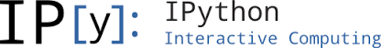
Machine Learning in Python
A few different libs available
scikit-learn is the standard (that we adopt)
Based on NumPy and SciPy
Often used with matplotlib
Data preparation in pandas
Often applied in IPython Notebooks
Notes:
scikit-lear is not the only machine learning module in Python; it is the mist well known, though

Slide 17
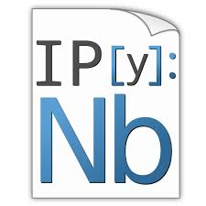
Jupyter Notebook
Our tool of choice; you'll love it (… we hope)
Standard for exploratory research with Python
Base for reproducible research
Combination of algorithms (in Python) and their annotations/explanation (in Markdown)

Slide 18
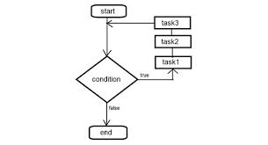
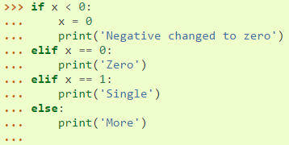
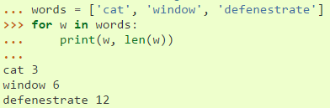
Control Structures
Python is an indentation based language: uses whitespace instead of curly braces

Slide 19
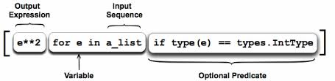
Comprehension
Create a compound data structure with a math-like language construction
Typical Python idiom: you will see it a lot
Examples:
[x for x in range(10,100) if x%2 = 0 and x%3 = 0]
{x: x**2 for x in range(5)}

Slide 20
List
Most versatile Python type.
Written as comma-separated values (items) between square brackets.
Lists might contain items of different types (but usually the all items have the same type).
Examples squares = [1, 4, 9, 16, 25] a = [1, [], 'Fontys']
List comprehension (idiomatic Python):
squares = [x**2 for x in range(10)]
List of lists: a = [[1,2,3], [4,5,6]]

Slide 21
Python: List Indexing & Slicing
Define: squares = [1,4,9,16,25]
Indexing: What is: squares[2]
→ 9
Slicing: What is: squares[0:3]
→ [1,4,9]
squares[0:4:2]
→ [1,9]
squares[:]
→ [1,4,9,16,25]
squares[::-1]
→ [25,16,9,4,1]

Slide 22
Python: Tuples and Dictionary
Lists and strings have many common properties, such as indexing and slicing.
They are two examples of sequence data types.
Other standard sequence data type are tuples and dictionaries.
Tuple is a number of values separated by commas t = (16, 9, 2015)
Dictionary consists of key-value pairs d = {'k1':1, 'k2':2, 'k3':3}

Slide 23
NumPy – Intro
Short for Numerical Python
Package for scientific computing & data analysis
Foundation for higher-level tools (such as scikit-learn)
NumPy provides:
ndarray, fast & efficient n-D array
Fast vectorized operations (without writting loops)
Linear algebra, random number generation, (Fourier) transformations
Tools for integration with C, C++, and Fortran

Slide 24
NumPy – Creating nD Arrays
# Convention
import numpy as np
A = np.array([1,2,3])
→ [1,2,3]
B = np.zeros((3,2))
→ [[0,0],
[0,0],
[0,0]]
c = np.arange(15, dtype=np.int32)
C = c.reshape(3,5)
→ [[ 0, 1, 2, 3, 4],
[ 5, 6, 7, 8, 9],
[10,11,12,13,14]
What is:
A + 4, A**2, 1/A
Notes:
Besides creating arrays with zeros you also have ones, eyes, empty …
Mention also np.linspace(a, b, step), np.random.randn(x, y)

Slide 25
NumPy – Functions
Boolean indexing (example) data = np.array([-0.1, 3.0, -7.2]]
What is:
data[data < 0] = 0
→ [ 0.0, 3.0, 0.0]
Elementwise operations (example) c = np.arange(15) C = c.reshape(3,5) D = np.ones([3,5]) E = np.add(C,D)
Also: sqrt, exp, log, isnan, power (all unary), minimum, multiply (binary)…

Slide 26
NumPy – Statistics
F = random.randn(100) # normal distribution
Aggregations (reductions):
F.mean() # or std, var
F.sum()
(F > 0.5).sum() # number of >0.5 values
F.cumsum()
bools = np.array([False, False, True, False])
bools.any()
→ True
bools.all()
→ False

Slide 27
NumPy – Linear Algebra
from numpy.linalg import inv
Matrix multiplication:
X.dot(Y)
(if X is m×n, Y must be n×m)
X = randn(5,5)
mat = X.T.dot(X)
inv(mat) # inverse matrix
What is:
mat.dot(inv(mat))

Slide 28
NumPy – Load & Save
Arrays are saved in raw binary format (*.npy)
arr = np.arange(10) np.save(‘myArray’, arr)
There is a savetxt variant
How to load arrays:
X = np.load(‘myArrat.npy’)
There is also a loadtxt variant!

Slide 29
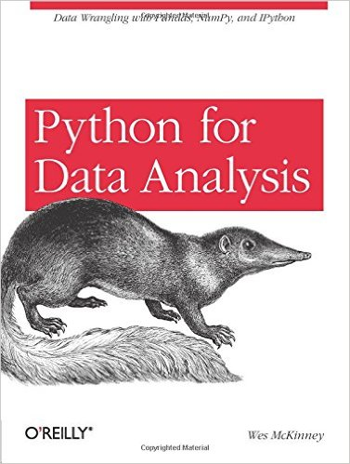

Pandas – Intro
Contains:
High-level data structures
Manipulation tools
Makes data analysis fast and easy.
Can handle missing values
Built on top of NumPy by Wes McKinney
Inspired by R

Slide 30
Pandas – Series
Convention:
import pandas as pd
1D array-like object containing:
Rows of data
Associated labels (called index)
Or …
Ordered dict, mapping index values to data values
Has a name attribute!
obj = pd.Series([4,NaN,-5], index=list('abc'))
→ a 4 b NaN c -5 dtype: float64
pd.isnull(obj) # returns Series obj with # dtype bool

Slide 31
Pandas – DataFrame
Tabular, spreadsheet-like data structure
Columns which hold different value types (numeric, string, boolean)
Has row and column index.
data = {‘state’: [‘NB’, ‘ZH’, ‘DR’], ‘year’ : [2010, 2011, 2012], ‘pop’ : [ 2.4, 3.6, 0.5]}
df = pd.DataFrame(data)
→ pop state year 0 2.4 NB 2010 1 3.6 ZH 2011 2 0.5 DR 2012

Slide 32
Pandas – Indexing Columns and Rows
Retrieve column:
df[‘state’]
→ state 0 NB 1 ZH 2 DR Name: state, dtype: object
Set column:
df[‘pop’] = 1.7
Retrieve dataframe row:
df.ix[2]
→ pop 1.7 state DR year 2012 Name: 2, dtype: object

Slide 33
Now it’s your turn!
Practice Notebooks
Python
NumPy
Pandas

